Slide 1
Blockchain in Electric Vehicle Charging
Diego Aulet-Leon
Vatsal Patel

Slide 2
Part 1: Introduction to Vehicle to Grid (V2G) and Potential Impact on Renewables

Slide 3
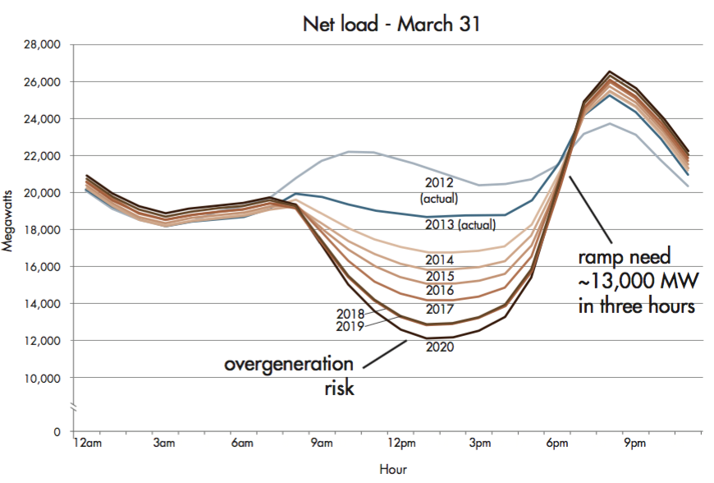
The Challenges of Adopting Renewables
Non Fossil sources accounted for 20% of U.S. energy consumption in 2019, and is growing
The rise in renewables has created an imbalance of daily power demand

Slide 4
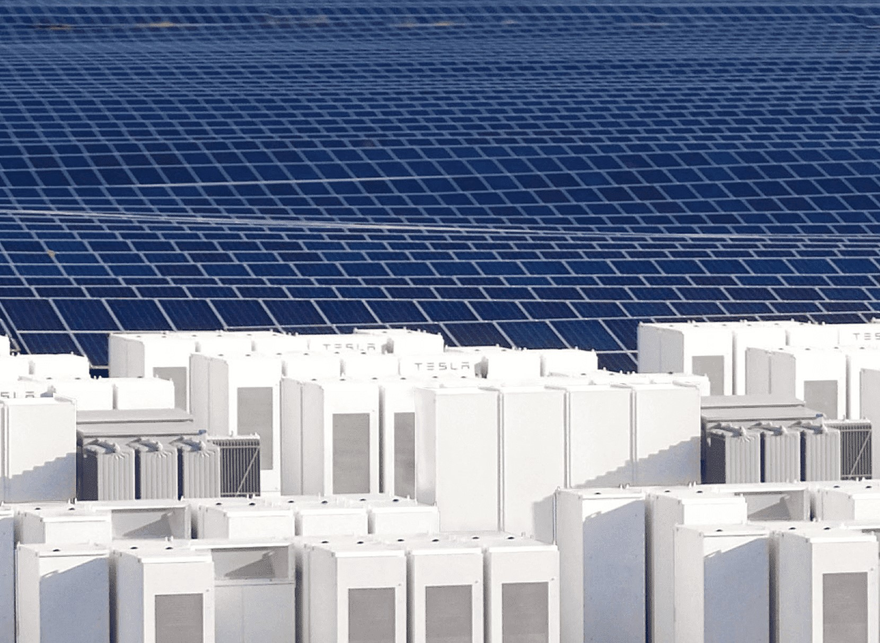
Solutions for Electric Grid Stability
Ideal solution: have a “battery” store power generated by renewables for peak hours.
Issue: Battery technology can not (yet) store sufficient power to meet demand without significant costs
Alternative solution: Allow for “microgrids” to handle power generation and storage at a smaller scale.

Slide 5
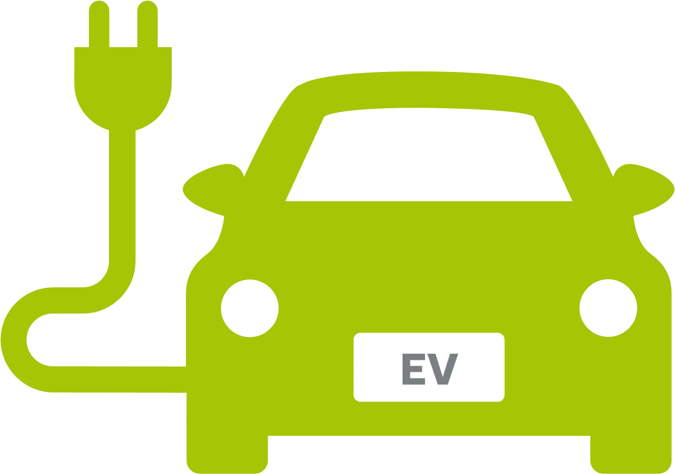
The Rise of Electric Vehicles (EVs)
Fossil-fuel vehicles are being phased out with Electric Vehicles (EVs) to help fight climate change
EV’s have battery sizes that range from 21-94 kilowatt hours (kWh).
Meanwhile, the average daily electricity consumption for a U.S. residential utility customer was 29.175 kWh in 2019
Therefore, what if we can use the energy in the EV battery to help with storing grid power, as well as supplying grid power during peak hours?

Slide 6
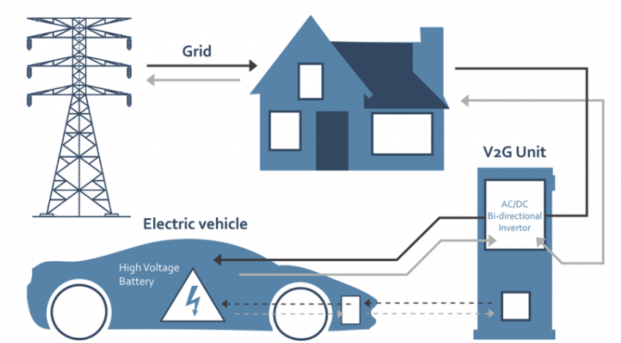
Vehicle to Grid (V2G)
V2G allows for vehicles to assert power back to the grid.
Can be used when there isn’t sufficient power from the grid.
Several EV’s using V2G can be used as a giant “battery” for the power grid
ISO 15118 Protocol is allowing for easier capabilities of V2G

Slide 7
Current Setbacks for Adopting V2G
Power Utilities can only buy limited energy back from consumers to remain financially stable.
To get credited for selling energy from EVs, money must flow through multiple financial institutions associated with the Power Utility.
Therefore, a new distribution model would need to be created to
(1) determine the electricity trading price and amount, and
(2) settle the trading price contract in an effective and secure manner.

Slide 8

Using Blockchain for Energy Transactions
Blockchain was built as a distributed ledger that permits transactions to be gathered into blocks and recorded.
It allows the resulting ledger to be accessed by different servers and which cryptographically chains blocks in chronological order.
Tho methods will be discussed; the Multi-Agent Coalition Model, and the Edge as a Service Model

Slide 9
Part 2: Multi-Agent Coalition Model

Slide 10
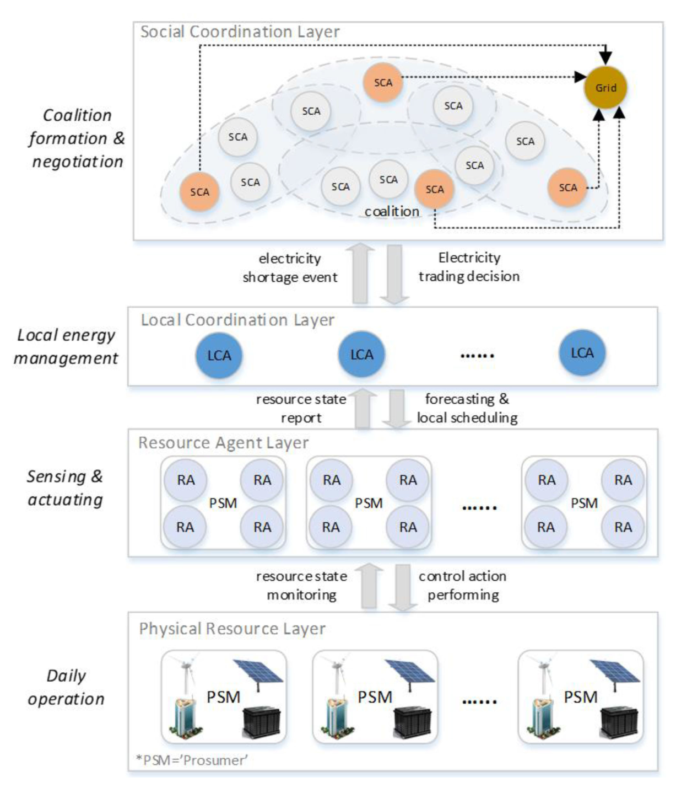
Multi Agent Energy Transaction System (MAS)
Multi-agent coalition refers to a way to cooperate agents to complete a task, where none of them can complete it independently.
A prosumer (producer and consumer) is modelled as a Multi-Agent System (MAS)
Resource Agents (RAs) are meant to perceive the operational status of status of energy resources from the MASs

Slide 11
Multi Agent Energy Transaction System
The Local Coordination Agent (LCA) gets energy resource information from RAs, and performs the energy management automatically.
If the LCA determines an energy shortage, the Social Coordination Agent (SCA) for the LCA negotiates with the grid and other corresponding SCAs to purchase the power at the lowest cost.

Slide 12
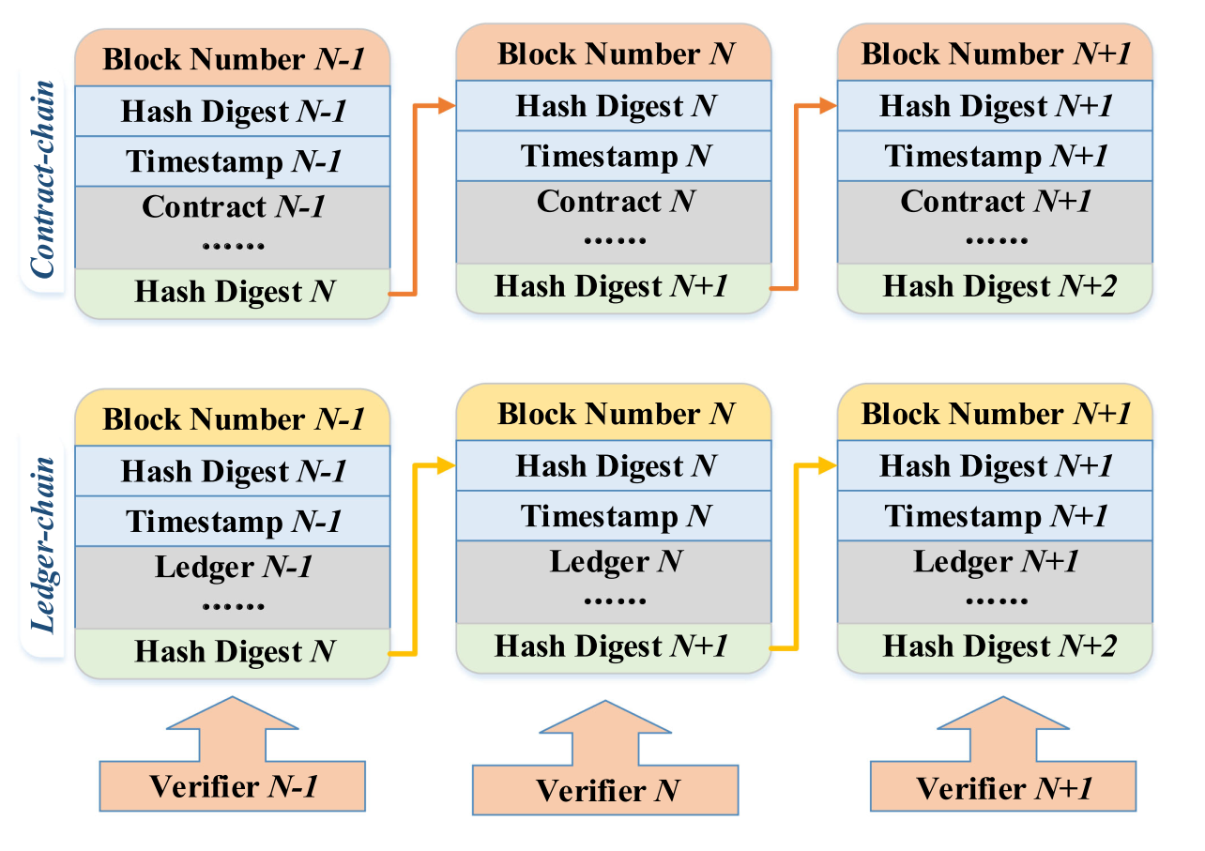
The Blockchain Module of the Multi Agent Coalition
Consists of a double-chain; the Contract Chain, and the Ledger Chain
Each block in the contract chain contains only one energy trading contract.
The ledger chain is the final financial settlement which corresponds to each contract block.
Each pair of contract-block and ledger-block is equipped with a high frequency verifier.

Slide 13
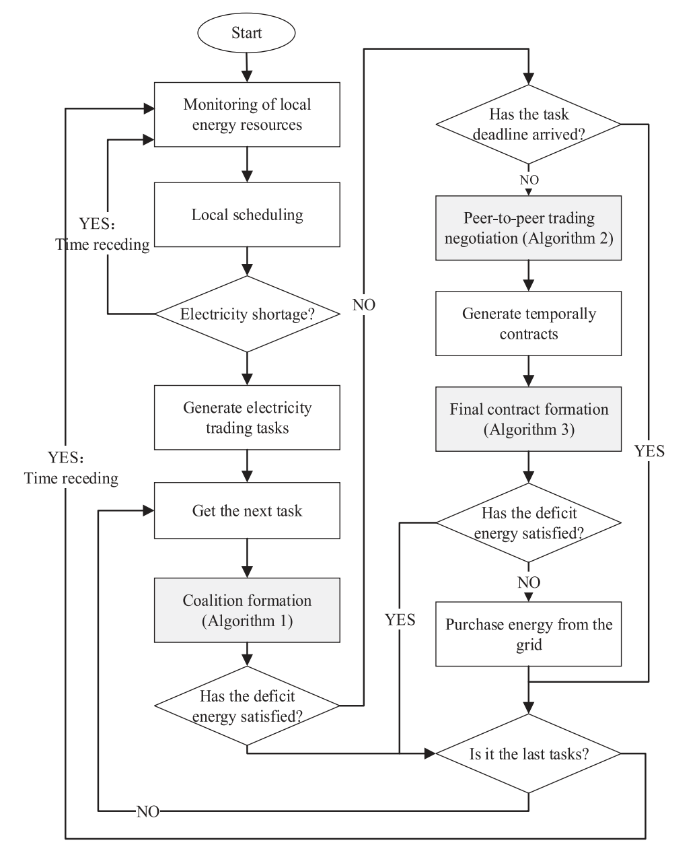
The MAS Energy Negotiation Process
The goal of this model is that the LCA uses the electricity retail price signed by the prosumer to calculate the price of power which the prosumer needs to buy from external suppliers.
Agent Coalition Formulation algorithm is executed to determine the contract to use for prosuming energy
After the trading deadline arrives, the buyer begins the price negotiation using the next algorithm, the Electricity Trading Negotiation Protocol.
When the trading deadline arrives, the negotiation is finished, and the Final Contract Determination Algorithm executes.

Slide 14
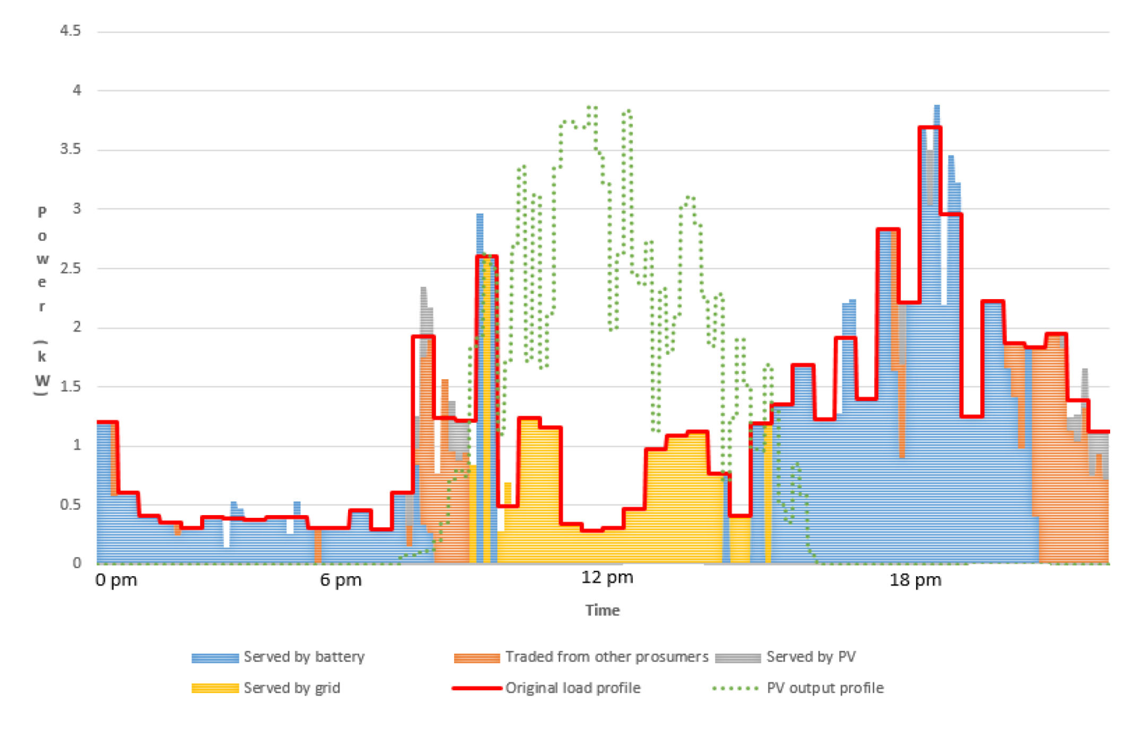
Model Simulation of MAS in Reviewed Paper
Uses Australian “Smart Grid, Smart City” dataset, showing electricity consumption data of more than 300 Australian residential users.
Residential users had photovoltaics and battery Energy Storage Systems (BESS).
Assuming that communication network traffic is not considered, the average negotiation time was less than one second (about 700 ms).
In the simulation, about 75-80% of deficit electricity transactions were satisfied by trading electricity with other prosumers.

Slide 15
Part 3: Edge As a Service Model

Slide 16
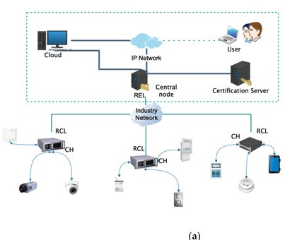
Edge As A Service (EAAS)
The Industrial Network consists of two major sections
Resource Constrained Layer (RCL)
Cluster Head (CH)
Keeps Local records and saves as blocks on RCL Blockchain
Edges (Power Stations)
Resource Extended Layer (REL)
Central Node (CN)
Talks with RCLs and keeps their records as main Block in REL Blockchain.
Certification Server (CS)
Looks for any anamolies in the blocks recorded.

Slide 17
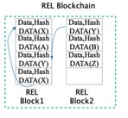
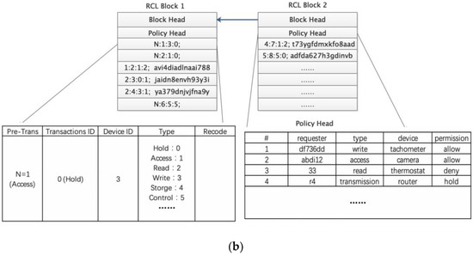
Dual BlockChains (REL and RCL)
Each RCL block contains a block head and a policy head. The blockhead stores the previous block hash, and the policy head maintains an access control list.
These control lists define RCL transactions and rules for communicating with REL.
Each REL block contains a block head and a transaction body.
The blockhead stores the previous block hash value, generator ID, and verifier’s signature. If illegitimate access attempts to change previously transactions, the hash value of the corresponding block will remain on the block and there will be inconsistencies, thus exposing this attack.

Slide 18
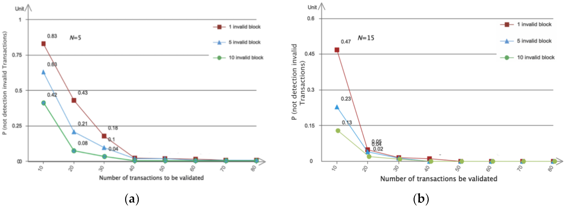
Efficiency and Probability
This Architecture utilizing the Layered Lightweight Blockchain Framework (LLBF) along with Bitcoin BTC for transactions and using dynamic high-throughput algorithm to verify legitimate transactions.
This graph shows the impact of the number of validators and invalid transactions in a block on the probability that no invalid transactions are detected during block validation. As the number of validators increased, we could reduce the percentage of transactions that needed to be validated without compromising the performance of invalid transaction detection.

Slide 19
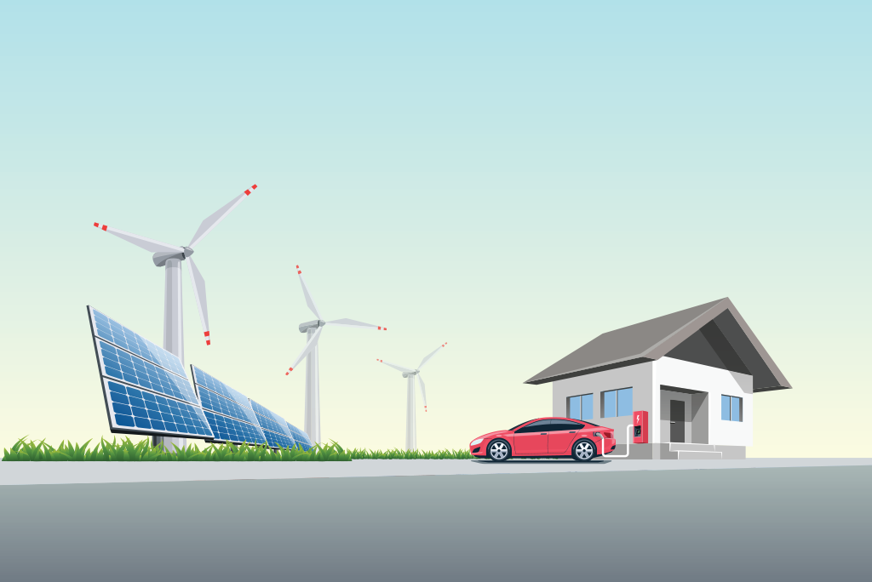
Final Thoughts
While these models provide a much better solution, adaptation has still become difficult
Suggestions
Start smaller with microgrids,
Quicker adoption of EVs
learn the protocols of EV charging
Expand with commercial charging networks

Slide 20
Image References
Roberts, David. “Solar Power's Greatest Challenge Was Discovered 10 Years Ago. It Looks like a Duck.” Vox, Vox, 20 Mar. 2018, www.vox.com/energy-and-environment/2018/3/20/17128478/solar-duck-curve-nrel-researcher.
Hanley, Steve. “Grid-Scale Battery Storage Accelerating In Colorado &amp; Australia.” CleanTechnica, 23 Oct. 2018, cleantechnica.com/2018/10/23/grid-scale-battery-storage-accelerating-in-colorado-australia/.
Pathrotkar, Pragati. “Vehicle-to-Grid Technology Market - Industry Outlook, Growth Prospects and Key Opportunities.” The Manufacturer PR Service, 18 Feb. 2020, pr.themanufacturer.com/vehicle-to-grid-technology-market-industry-outlook-growth-prospects-and-key-opportunities/.
Wenzel, Elsa. “Vehicle to Grid (V2G) Technology.” IEEE Innovation at Work, 22 Nov. 2019, innovationatwork.ieee.org/vehicle-to-grid-v2g-technology/.

